Slide 1
Capstone Project - The Battle of Neighborhoods (Week 2)- Private Property Sales Prices Data Analysis of Singapore
By: Su Yiping

Slide 2
contents
Introduction
Objectives
Python Tools
About Data Set
Methodology
data Visualization
Conclusion
Reference

Slide 3
Introduction
Singapore is one of high population density countries
Buying Real estate is generally a important and long-term investment
Many factors influence the property price, How do these factors affect project
a group of stakeholders have a plan that is acquisition and sell of real estate for white collar

Slide 4
Objectives
By analysis of the surrounding environment and property situation，Provide a reasonable price for the company to obtain the maximum profit
Through this project, we analyze the following things:
the top 10 commercial activities in each district
real estate sales price situation from 1975 to 2019
the unit price, area and total price of private property sales in each district from March 2017 to March 2020. etc.

Slide 5
Python Tools
Panda package
BeautifulSoup package
Geocoder package
Nominatim package
folium package
k-means package
tqdm package
Numpy package
deque package
Axes3D package
seaborn package
WordCloud package
random package

Slide 6
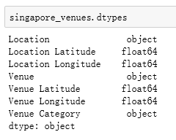
About Data Set-the general location

Slide 7
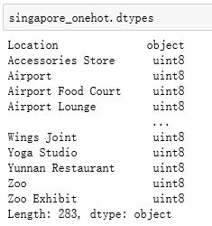
the venue category with a one hot enconding

Slide 8
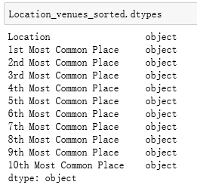
Top 10 common business

Slide 9
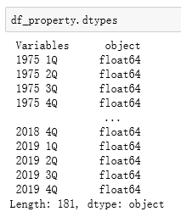
Private Residential Property Prices Data from 1975 1Q to 2019 4Q

Slide 10
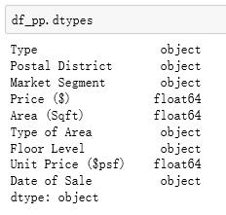
The private property sale

Slide 11
Methodology
Collect the data
Explore the data
Visualize the map
Data pre-processing
Clusters in Singapore
Analysis the data
Data Visualization

Slide 12
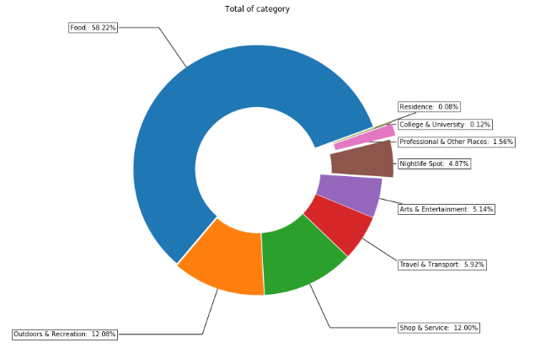
Visualization Tools
Using Pie Graph Top Business Type Ratio for Singapore

Slide 13
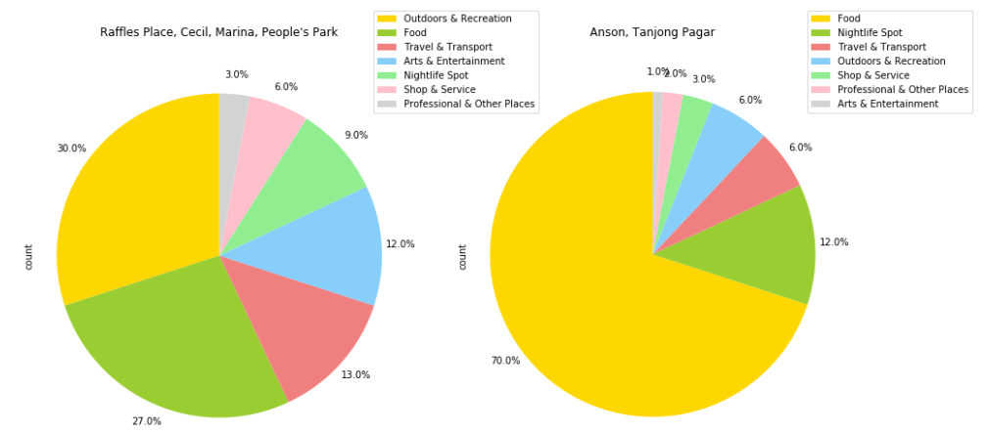
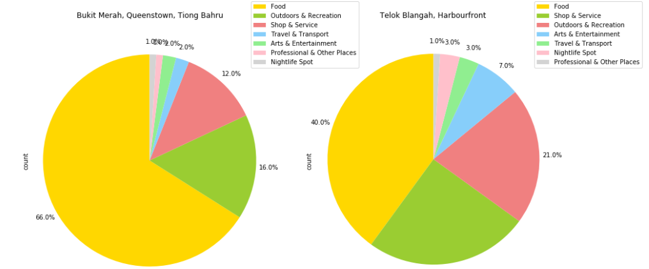
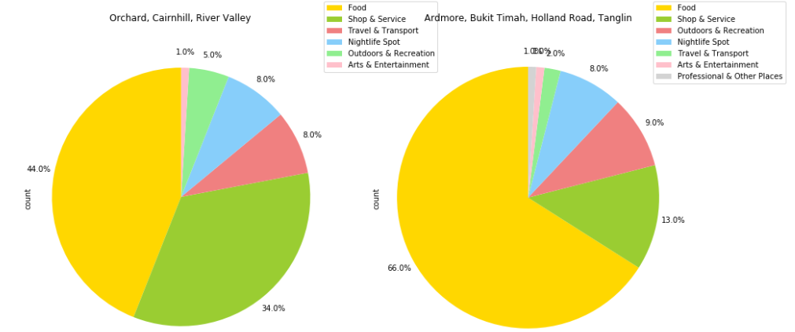
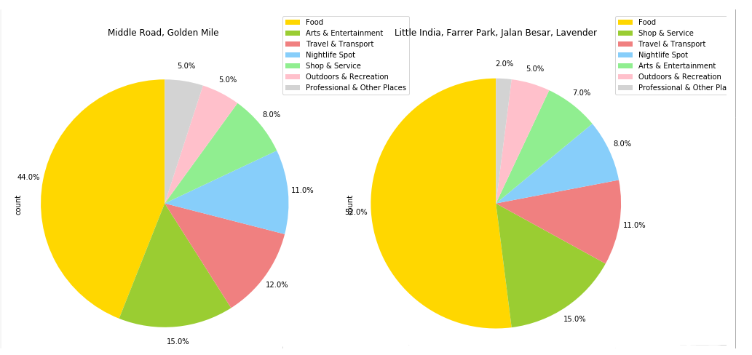
Visualization Tools
Using Pie Chart to Analyze Top Business Type for Every General

Slide 14
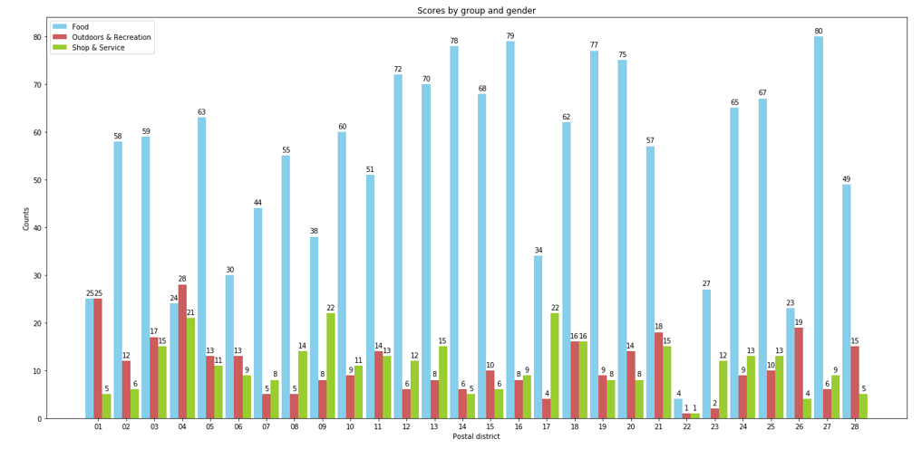
Visualization Tools
Using Bar Graph to Analyze Food, Outdoors & Recreation and Shop & Service for Postal District in Singapore

Slide 15
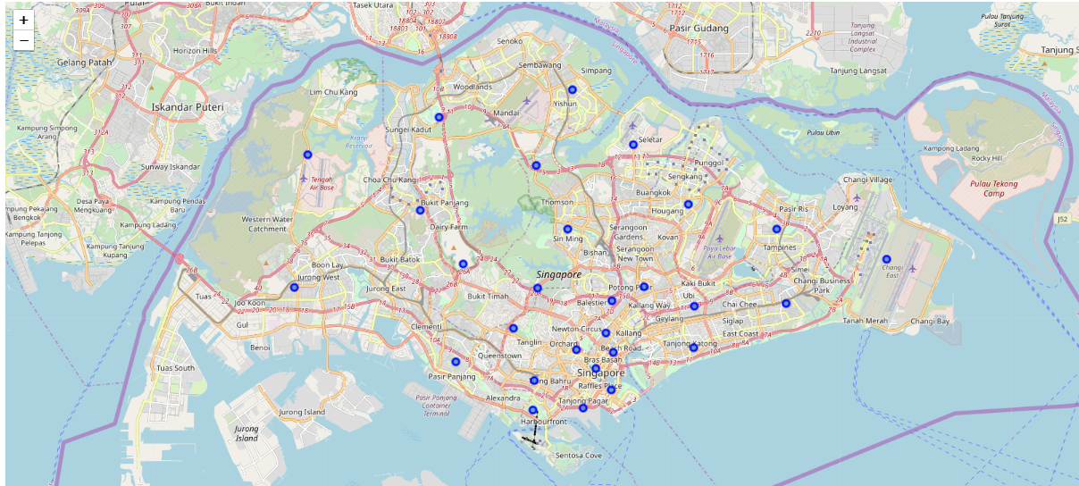
Visualization Tools
The geographical visualization of the different location for Singapore

Slide 16
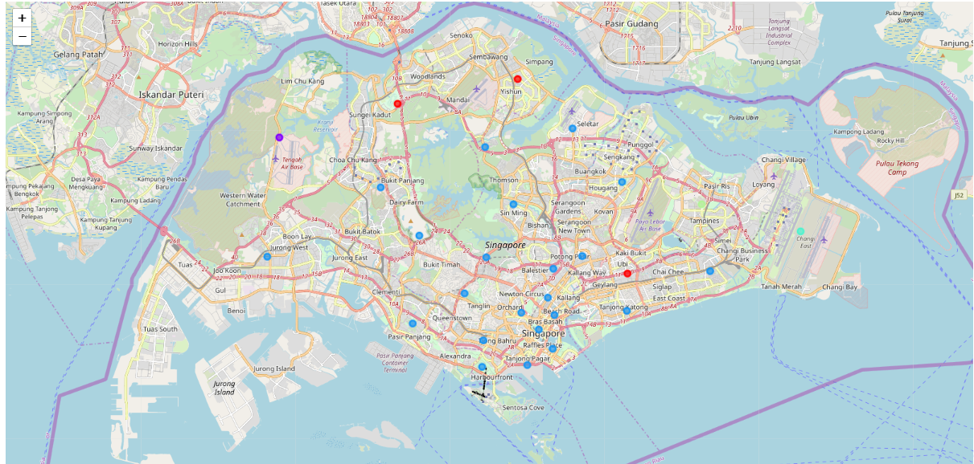
Visualization Tools
The K-Means geographical visualization

Slide 17
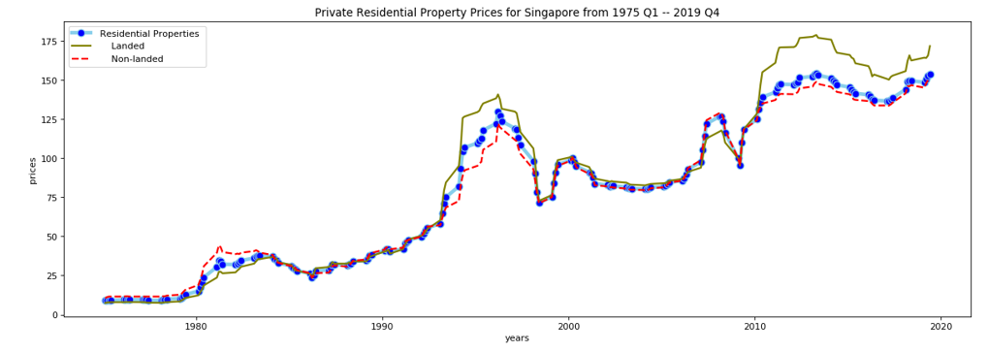
Visualization Tools

Slide 18
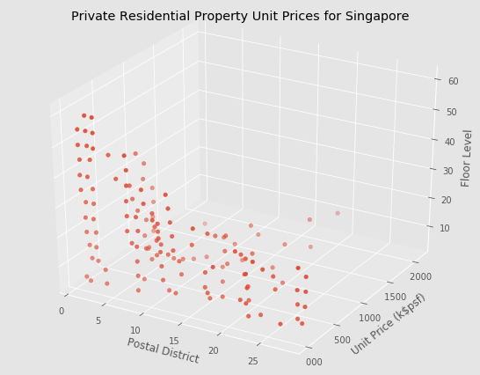
Visualization Tools

Slide 19
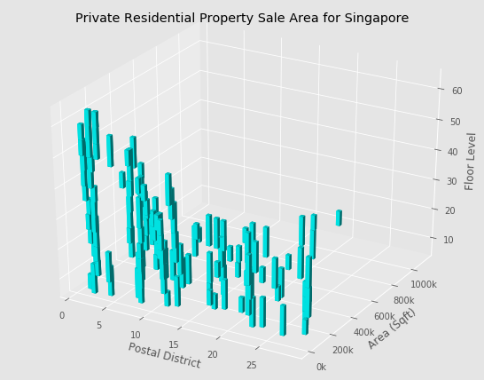
Visualization Tools

Slide 20
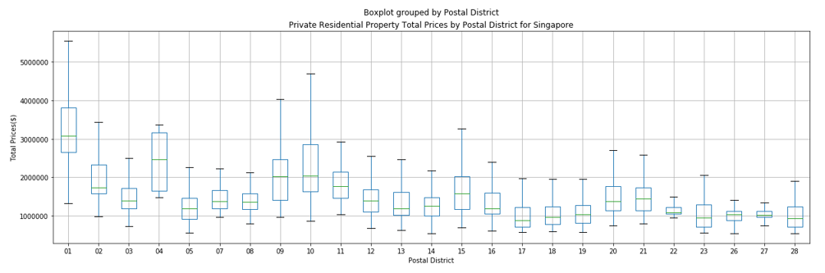
Visualization Tools

Slide 21
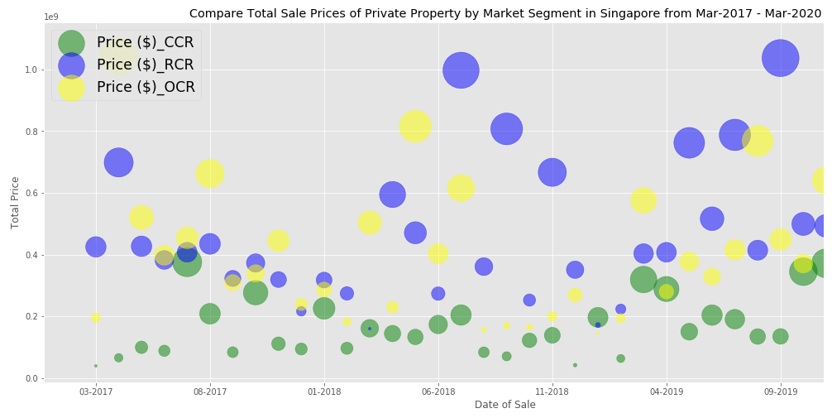
Visualization Tools

Slide 22
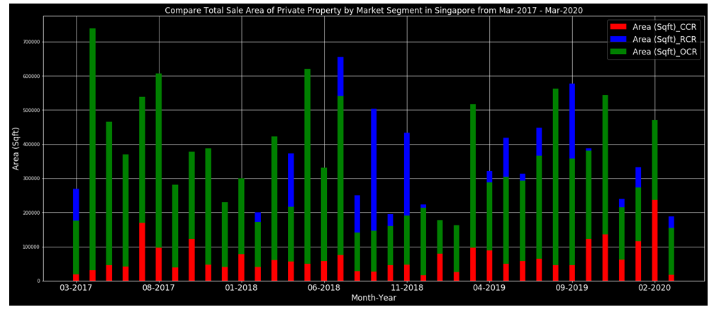
Visualization Tools

Slide 23
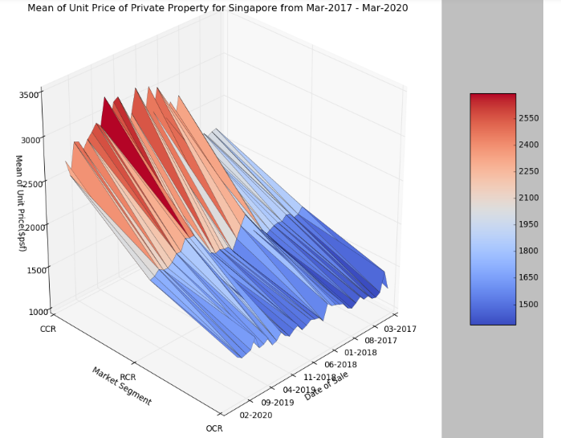
Visualization Tools

Slide 24
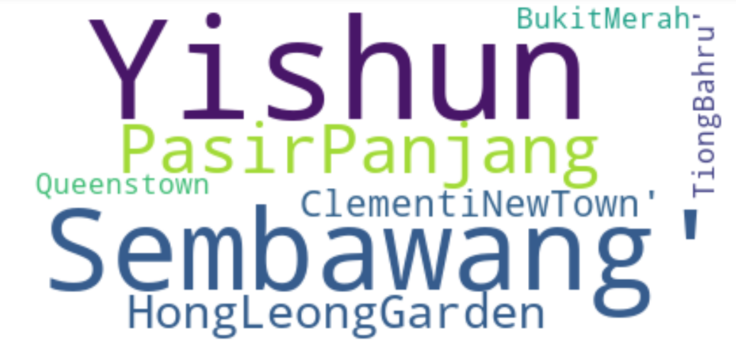
Visualization Tools

Slide 25
Conclusion
the Private Residential Property Prices may be higher and higher, and landed properties higher than Non-landed properties, if don’t have COVID-19.
Food, outdoors & recreation and shop & Service are the most mainly commercial activities surround the property.
Properties of Post District 01(Raffles Place, Cecil, Marina, People's Park) lie in CCR Market segment are mainly the High-rise buildings and the highest total sale prices, more and more sought-after house.
by visualizing the data and clustering information, we can clearly discover a lot of sale factor and help us make a better decition.

Slide 26
Reference
1. Postal codes in Singapore ( https://en.wikipedia.org/wiki/Postal_codes_in_Singapore)
2. Real Residential Property Prices for Singapore (https://fred.stlouisfed.org/series/QSGR628BIS)
3. Private Residential Properties (https://www.ura.gov.sg/Corporate/Property/Property-Data/Private-Residential-Properties)

